Slide 1
CSE477
VLSI Digital Circuits
Fall 2002
Lecture 19: Timing Issues;
Introduction to Datapath Design
Mary Jane Irwin ( www.cse.psu.edu/~mji ) www.cse.psu.edu/~cg477
[Adapted from Rabaey’s Digital Integrated Circuits, ©2002, J. Rabaey et al.]

Slide 2
Review: Sequential Definitions
Use two level sensitive latches of opposite type to build one master-slave flipflop that changes state on a clock edge (when the slave is transparent)
Static storage
  static uses a bistable element with feedback to store its state and thus preserves state as long as the power is on
    Loading new data into the element: 1) cutting the feedback path (mux based); 2) overpowering the feedback path (SRAM based)
Dynamic storage
  dynamic stores state on parasitic capacitors so the state held for only a period of time (milliseconds); requires periodic refresh
  dynamic is usually simpler (fewer transistors), higher speed, lower power but due to noise immunity issues always modify the circuit so that it is pseudostatic
Notes:
Dynamic storage requires periodic refresh of the value.
Reading the value of the stored signal from a capacitor without disrupting the charge requires the availability of a device with a high input impedance

Slide 3
Timing Classifications
Synchronous systems
  All memory elements in the system are simultaneously updated using a globally distributed periodic synchronization signal (i.e., a global clock signal)
  Functionality is ensure by strict constraints on the clock signal generation and distribution to minimize
    Clock skew (spatial variations in clock edges)
    Clock jitter (temporal variations in clock edges)
Asynchronous systems
  Self-timed (controlled) systems
  No need for a globally distributed clock, but have asynchronous circuit overheads (handshaking logic, etc.)
Hybrid systems
  Synchronization between different clock domains
  Interfacing between asynchronous and synchronous domains

Slide 4
Review: Synchronous Timing Basics
R1
R2
In
Combinational
logic
D
Q
D
Q
t_{clk1}
t_{clk2}
clk
t_{c-q}, t_{su},
t_{hold}, t_{cdreg}
t_{plogic}, t_{cdlogic}
Under ideal conditions (i.e., when t_{clk1} = t_{clk2})
T ≥ t_{c-q} + t_{plogic} + t_{su}
t_{hold} ≤ t_{cdlogic} + t_{cdreg}
Under real conditions, the clock signal can have both spatial (clock skew) and temporal (clock jitter) variations
  skew is constant from cycle to cycle (by definition); skew can be positive (clock and data flowing in the same direction) or negative (clock and data flowing in opposite directions)
  jitter causes T to change on a cycle-by-cycle basis
Notes:
Skew delta is tphi’’ – tphi’ where tphi’s are the local clock times. Skew can be positive or negative depending on the routing direction of the clock.
tmin’s are the best case delays of the logic, tmax are the worst case delays (assume register set up time is included in the combinational logic time). ti is the propagation delay of the interconnect.
Clock skew is due to spatial variations in the arrival time of a clock transition
skew is constant from cycle to cycle (by definition)
can be positive (clock and data flowing in the same direction) or negative (clock and data flowing in the opposite direction)
Clock jitter is due to temporal variations in the clock period (T changes on a cycle-by-cycle basis)

Slide 5
Sources of Clock Skew and Jitter in Clock Network
4
power supply
3
interconnect
clock generation
6
capacitive load
1
PLL
7
capacitive coupling
2
clock drivers
5
temperature
Skew
  manufacturing device variations in clock drivers
  interconnect variations
  environmental variations (power supply and temperature)
Jitter
  clock generation
  capacitive loading and coupling
  environmental variations (power supply and temperature)
Notes:
clock is distributed using multiple matched paths to the sequential elements. The clock path includes the wiring and the associated distributed buffers required to drive the interconnect and loads.
What matters is the relative arrival time at the register points at the end of each path – not the absolute delay through the clock distribution path.
Both systematic (nominally identical from chip to chip and predictable – so easy to model and correct for at design time) and random (due to manufacturing variations – so are difficult to model and eliminate)

Slide 6
Positive Clock Skew
Clock and data flow in the same direction
R1
R2
In
Combinational
logic
D
Q
D
Q
t_{clk1}
t_{clk2}
clk
delay
T
T + δ
1
δ > 0
3
2
4
δ + t_{hold}
T :
t_{hold} :
Notes:
For class handout

Slide 7
Positive Clock Skew
Clock and data flow in the same direction
R1
R2
In
Combinational
logic
D
Q
D
Q
t_{clk1}
t_{clk2}
clk
delay
T
T + δ
1
δ > 0
3
2
4
δ + t_{hold}
T + δ ≥ t_{c-q} + t_{plogic} + t_{su} so T ≥ t_{c-q} + t_{plogic} + t_{su} - δ
t_{hold} + δ ≤ t_{cdlogic} + t_{cdreg} so t_{hold} ≤ t_{cdlogic} + t_{cdreg} - δ
T :
t_{hold} :
δ > 0: Improves performance, but makes t_{hold} harder to meet. If t_{hold} is not met (race conditions), the circuit malfunctions independent of the clock period!
Notes:
For lecture
clock skew has the potential to improve the performance of the circuit.
Unfortunately, increasing skew makes the circuit more susceptible to race conditions! If the minimum delay of the combinational logic block is small, the inputs to R2 may change before R2’s first rising edge. To avoid races, we must ensure that the minimum delay through the register and logic must e long enough that the inputs to R2 are valid for a hold time after that edge. Reducing the clock frequency can’t fix it!

Slide 8
Negative Clock Skew
Clock and data flow in opposite directions
R1
R2
In
Combinational
logic
D
Q
D
Q
t_{clk1}
t_{clk2}
clk
delay
T
T + δ
1
3
2
δ < 0
4
T :
t_{hold} :
Notes:
For class handout

Slide 9
Negative Clock Skew
Clock and data flow in opposite directions
R1
R2
In
Combinational
logic
D
Q
D
Q
t_{clk1}
t_{clk2}
clk
delay
T
T + δ
1
3
2
δ < 0
4
T + δ ≥ t_{c-q} + t_{plogic} + t_{su} so T ≥ t_{c-q} + t_{plogic} + t_{su} - δ
t_{hold} + δ ≤ t_{cdlogic} + t_{cdreg} so t_{hold} ≤ t_{cdlogic} + t_{cdreg} - δ
T :
t_{hold} :
δ < 0: Degrades performance, but t_{hold} is easier to meet (eliminating race conditions)
Notes:
For lecture
a negative skew adversely impacts the performance of the system.
However, assuming thold + delta < tcdreg + tcdlogic, a negative skew implies that the system never fails since edge 2 happens before edge 1 – i.e., there is never a race condition.
Unfortunately, for general logic signals flow in both directions so skew can be both positive and negative in the same circuit

Slide 10
Clock Jitter
Jitter causes T to vary on a cycle-by-cycle basis
R1
Combinational
logic
In
t_{clk}
clk
T
-t_{jitter}
+t_{jitter}
T :
Notes:
for class handout

Slide 11
Clock Jitter
Jitter causes T to vary on a cycle-by-cycle basis
R1
Combinational
logic
In
t_{clk}
clk
T
-t_{jitter}
+t_{jitter}
T :
T - 2t_{jitter} ≥ t_{c-q} + t_{plogic} + t_{su} so T ≥ t_{c-q} + t_{plogic} + t_{su} + 2t_{jitter}
Jitter directly reduces the performance of a sequential circuit
Notes:
for lecture

Slide 12
Combined Impact of Skew and Jitter
Constraints on the minimum clock period (δ > 0)
R1
R2
In
Combinational
logic
D
Q
D
Q
t_{clk1}
t_{clk2}
T
T + δ
1
δ > 0
6
12
-t_{jitter}
T ≥ t_{c-q} + t_{plogic} + t_{su} - δ + 2t_{jitter} t_{hold} ≤ t_{cdlogic} + t_{cdreg} – δ – 2t_{jitter}
δ > 0 with jitter: Degrades performance, and makes t_{hold} even harder to meet. (The acceptable skew is reduced by jitter.)

Slide 13
Clock Distribution Networks
Clock skew and jitter can ultimately limit the performance of a digital system, so designing a clock network that minimizes both is important
  In many high-speed processors, a majority of the dynamic power is dissipated in the clock network.
  To reduce dynamic power, the clock network must support clock gating (shutting down (disabling the clock) units)
Clock distribution techniques
  Balanced paths (H-tree network, matched RC trees)
    In the ideal case, can eliminate skew
    Could take multiple cycles for the clock signal to propagate to the leaves of the tree
  Clock grids
    Typically used in the final stage of the clock distribution network
    Minimizes absolute delay (not relative delay)

Slide 14
H-Tree Clock Network
If the paths are perfectly balanced, clock skew is zero
Can insert clock gating at
multiple levels in clock tree
Can shut off entire subtree
if all gating conditions are
satisfied
Clock
Idle
condition
Gated
clock
Clock
Notes:
Things to consider – interconnect material used for routing clock, shape of network, clock drivers and buffers used, load on clock lines, rise and fall time of clock (may have to consider transmission line effects as well!!)
The H-tree network also helps with the clock skew problem (helps to minimize skew between neighboring elements) since only relative skew is important.

Slide 15
DEC Alpha 21164 (EV5)
300 MHz clock (9.3 million transistors on a 16.5x18.1 mm die in 0.5 micron CMOS technology)
  single phase clock
3.75 nF total clock load
  Extensive use of dynamic logic
20 W (out of 50) in clock distribution network
Two level clock distribution
  Single 6 stage driver at the center of the chip
  Secondary buffers drive the left and right sides of the clock grid in m3 and m4
Total equivalent driver size of 58 cm !!
Notes:
0.55 micron CMOS, 4 layer metal
Clock load accounts for 40% of the total effective capacitance of the chip

Slide 16
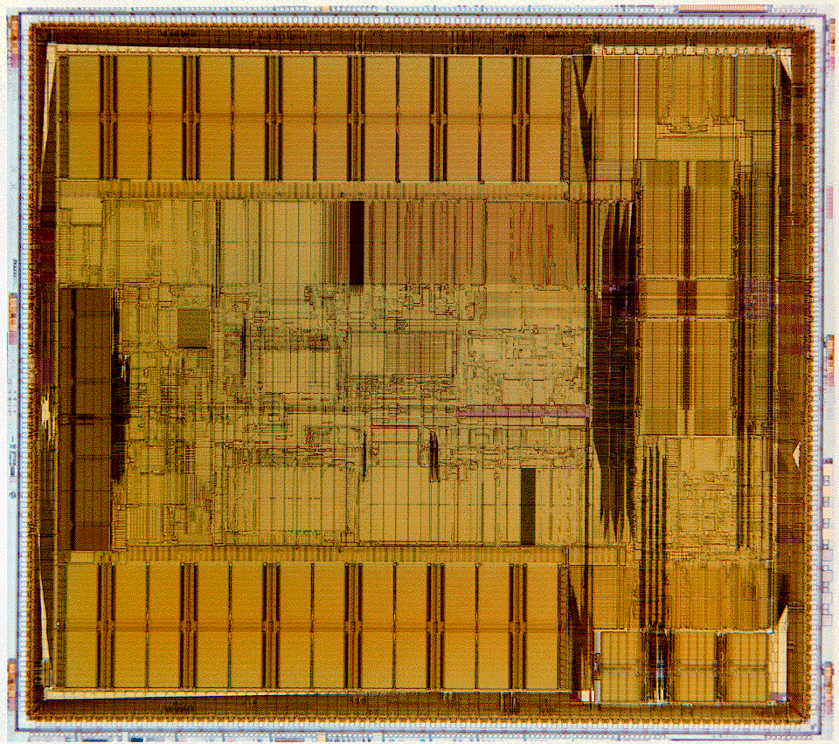

Slide 17
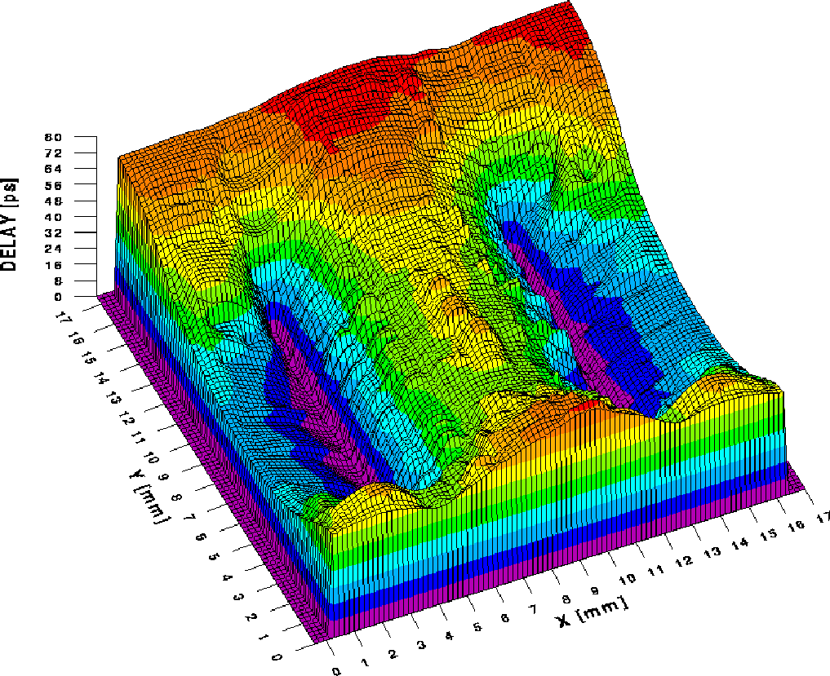
Clock Skew in Alpha Processor
Absolute skew smaller than 90 ps
The critical instruction and execution units all see the clock within 65 ps

Slide 18
Dealing with Clock Skew and Jitter
To minimize skew, balance clock paths using H-tree or matched-tree clock distribution structures.
If possible, route data and clock in opposite directions; eliminates races at the cost of performance.
The use of gated clocks to help with dynamic power consumption make jitter worse.
Shield clock wires (route power lines – V_{DD} or GND – next to clock lines) to minimize/eliminate coupling with neighboring signal nets.
Use dummy fills to reduce skew by reducing variations in interconnect capacitances due to interlayer dielectric thickness variations.
Beware of temperature and supply rail variations and their effects on skew and jitter. Power supply noise fundamentally limits the performance of clock networks.

Slide 19
Major Components of a Computer
Processor
Devices
Control
Memory
Input
Datapath
Output
Modern processor architecture styles (CSE 431)
  Pipelined, single issue (e.g., ARM)
  Pipelined, hardware controlled multiple issue – superscalar
  Pipelined, software controlled multiple issue – VLIW
  Pipelined, multiple issue from multiple process threads - multithreaded
Notes:
That is, any computer, no matter how primitive or advance, can be divided into five parts:
1. The input devices bring the data from the outside world into the computer.
2. These data are kept in the computer’s memory until ...
3. The datapath request and process them.
4. The operation of the datapath is controlled by the computer’s controller.
All the work done by the computer will NOT do us any good unless we can get the data back to the outside world.
5. Getting the data back to the outside world is the job of the output devices.
The most COMMON way to connect these 5 components together is to use a network of busses.
Workstation Design Target: 25% of cost on Processor, 25% of cost on Memory (minimum memory size), rest on I/O devices, power supplies, box

Slide 20
Basic Building Blocks
Datapath
  Execution units
    Adder, multiplier, divider, shifter, etc.
  Register file and pipeline registers
  Multiplexers, decoders
Control
  Finite state machines (PLA, ROM, random logic)
Interconnect
  Switches, arbiters, buses
Memory
  Caches, TLBs, DRAM, buffers

Slide 21
MIPS 5-Stage Pipelined (Single Issue) Datapath
Fetch
Decode
Execute
Memory
WriteBack
1
pipeline
stage
isolation
register
0
Add
Add
4
Shift
left 2
I$
Read Addr 1
D$
Register
File
Read
Data 1
Address
Read Addr 2
PC
Read
Address
IF/Dec
Read
Data
Write Addr
Dec/Exec
ALU
1
Read
Data 2
0
Exec/Mem
Mem/WB
Write Data
Write Data
0
1
Sign
Extend
Icache
precharge
16
32
Dcache
precharge
RegWrite
clk
Notes:
Five stage pipeline (originally for performance, but also helps with energy)
Talk a bit about a vertical design approach versus a horizontal approach

Slide 22
Datapath Bit-Sliced Organization
Control Flow
Bit 3
Bit 2
From I$
Pipeline Register
Multiplexer
Register File
Pipeline Register
Multiplexer
Adder
Shifter
Pipeline Register
Pipeline Register
Bit 1
Bit 0
Data Flow
To/From D$
Tile identical bit-slice elements

Slide 23
Next Lecture and Reminders
Next lecture
  Adder design
    Reading assignment – Rabaey, et al, 11.3
Reminders
  Pick up second half of the new edition of the book from Sue in 202 Pond Lab
  Project final reports due December 5th
  HW4 due today
  HW5 due November 19th
  Final grading negotiations/correction (except for the final exam) must be concluded by December 10th
  Final exam scheduled
    Monday, December 16th from 10:10 to noon in 118 and 121 Thomas

